Slide 1




Gere planos de ação a partir de análises com SQL

Slide 2
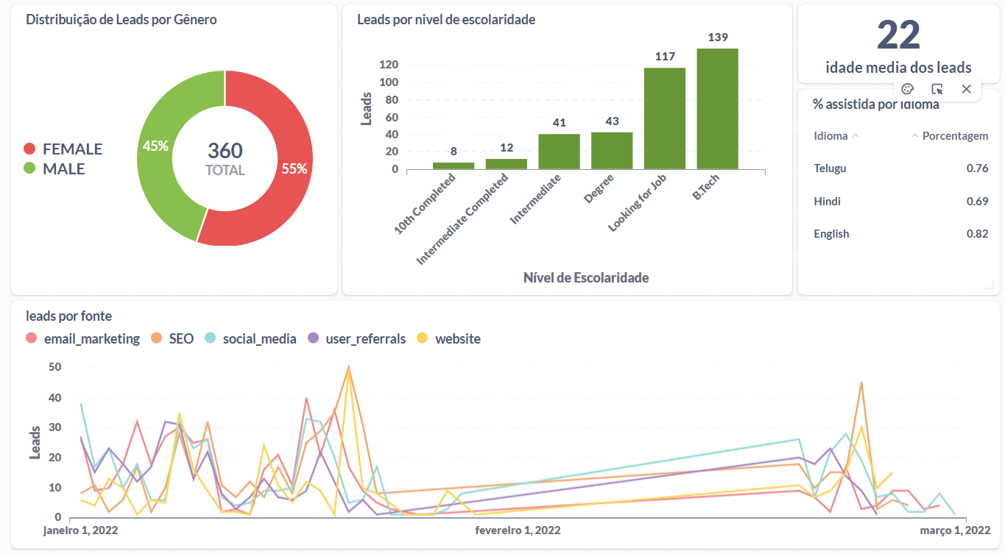
Dashboard
Insira o print do dashboard aqui

Slide 3
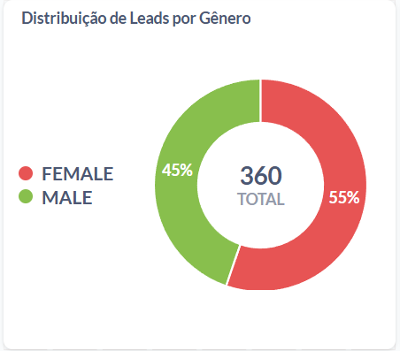
Gráfico 1 - PIZZA
Query realizada
Insira o gráfico de Pizza Aqui
Select gender, count(lead_id) from leads_basic_details group by gender

Slide 4
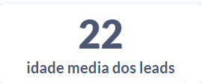
Gráfico 2 - CARTÃO
Query realizada
Insira o gráfico de Cartão Aqui
Select round(avg(age)) from leads_basic_details

Slide 5
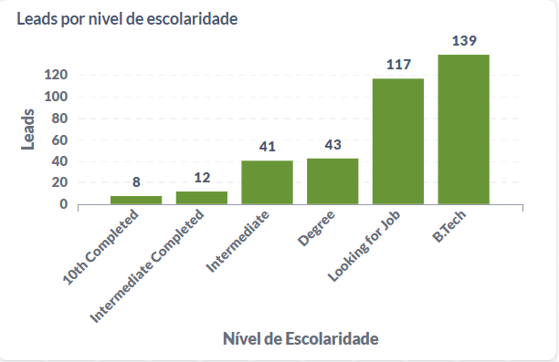
Gráfico 3 - BARRAS
Query realizada
Insira o gráfico de Barras Aqui
Select current_education, count(lead_id) from leads_basic_details group by current_education order by count(lead_id)

Slide 6
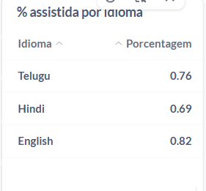
Gráfico 4 - TABELA
Query realizada
Insira a tabela Aqui
Select language as Idioma, avg(watched_percentage) as Porcentagem from leads_demo_watched_details where watched_percentage > 0.5 group by language

Slide 7
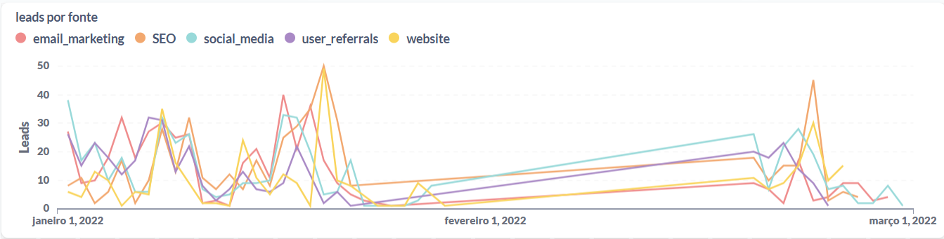
Gráfico 5 - LINHAS
Insira o gráfico aqui
Query realizada
Select call_done_date, lead_gen_source, count(leads_interaction_details.lead_id) from leads_interaction_details left join leads_basic_details on leads_interaction_details.lead_id = leads_basic_details.lead_id group by call_done_date, lead_gen_source order by call_done_date, lead_gen_source

